Slide 1

RELATING MUDMASTER MOTEC PERFORMANCE TO SATELLITE MOISTURE INDEX
MOISTURE CONTENT ANALYSIS IN MINING TAILINGS
Prepared by David Yang

Slide 2

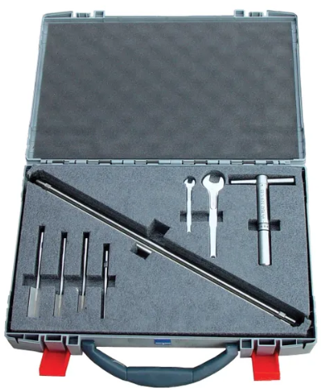
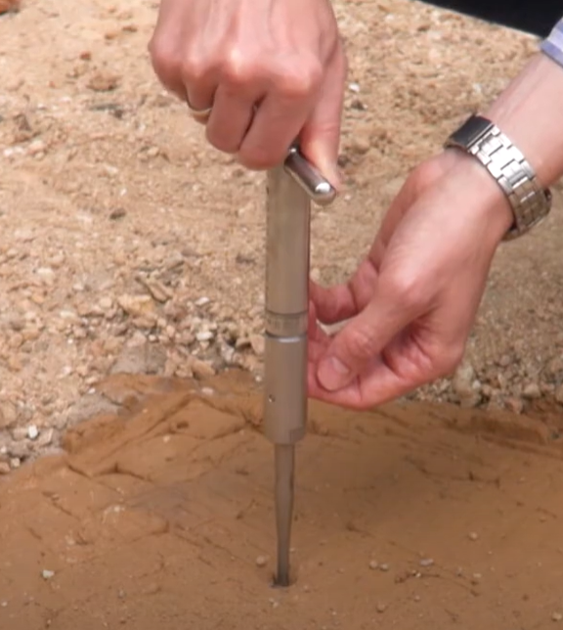
CHALLENGES WITH EXISTING MOISTURE MEASUREMENT METHODS
SHEAR VANE
Labor-intensive and time-consuming
Requires physical sampling, causing delays
Highly localized, does not provide continuous spatial coverage
SATELLITE-BASED MOISTURE IMAGERY
Low resolution, limited by cloud cover
No regular updates
Requires ground truth data for accurate calibration

Slide 3



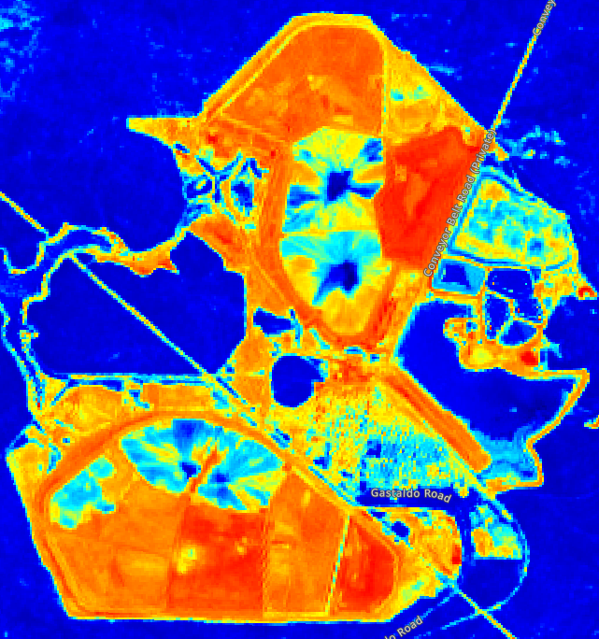
DATA SOURCES
Mudmaster MoTec Data:
GPS, torque, traction, speed, etc
Sentinel-2 Satellite Data:
SWIR (B11) & NIR (B8A) bands
Datetime | Longitude | Latitude | Traction | Torque | Speed | Traction Diff
27/01/2025 6:49 | -33.2141 | 116.0602 | 85.833331 | 76.91667 | 1.2 | 0.197
27/01/2025 6:50 | -33.2141 | 116.0605 | 89.099998 | 78.05 | 1.2 | 0.2895
27/01/2025 6:51 | -33.2141 | 116.0607 | 89.566666 | 78.01667 | 1.27 | 0.319
27/01/2025 6:52 | -33.2141 | 116.0608 | 89.866666 | 77.35 | 1.35 | 0.3285
27/01/2025 6:53 | -33.2141 | 116.0609 | 90.933332 | 76.48333 | 1.52 | 0.292
Latitude | Longitude | Moisture Index
-33.2141 | 116.0602 | 0.3517
-33.2141 | 116.0605 | 0.3637
-33.2141 | 116.0607 | 0.3907
-33.2141 | 116.0608 | 0.3907
-33.2141 | 116.0609 | 0.3936

Slide 4



DATA ANALYSIS & MACHINE LEARNING
Data collecting & Preprocessing
Data Integration
Machine Learning

Slide 5

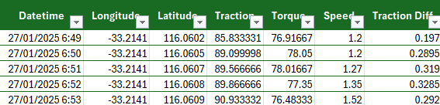
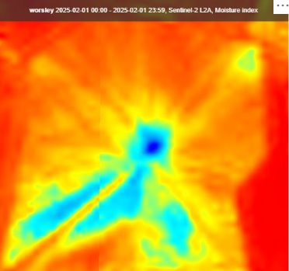
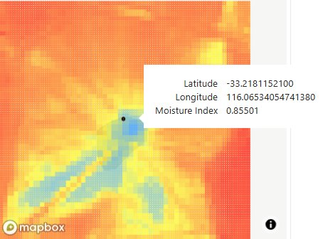
RESULTS & IMPACT
MudMaster MoTeC
Worsley
2025/01/27
Trained Machine Model
MSE :1.5%
R² : 0.590001
Sentinel-2 Satellite
Worsley
2025/01/27

Slide 6



FUTURE RESEARCH DIRECTION
- Enhancing models with density sensors
- Extending methodology to other mining sites
- Exploring NISAR (Deep Penetration, InSAR for surface deformation)

